Slide 1
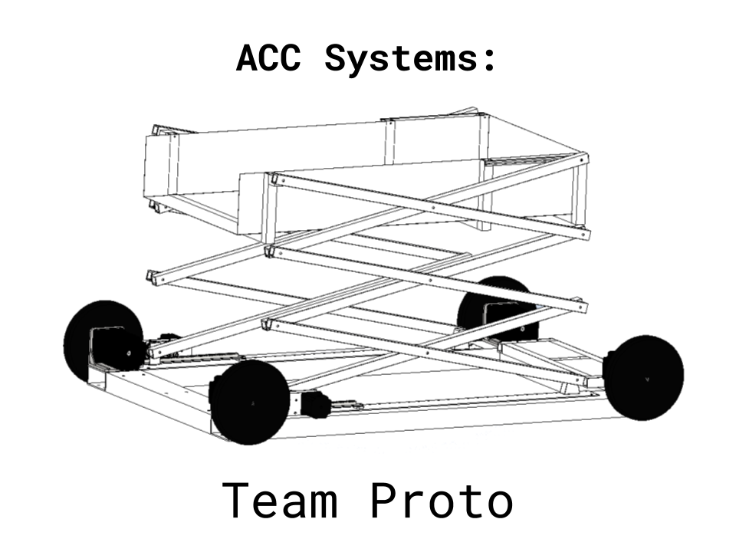
Intel Server Robot
Senior Design Final Report
ME 498 | Dr. Duan | Summer ‘20
Saint Martin’s University
Presentation by Ariful Islam, Chad Campbell and Christian Merrikin
Notes:
Chad

Slide 2

Agenda
Team Roles
Initial Design Ideas
Final Design
Operation Flow
Design Analysis
Safety Factor Based Analysis
Physical Component Analysis
System Dynamics and Torque
Electromechanical Components Analysis
Feedback Controller
Computer System and Sensor
Programming and Coding
Design Review
Senior Design II Considerations
Questions
Notes:
Chad

Slide 3

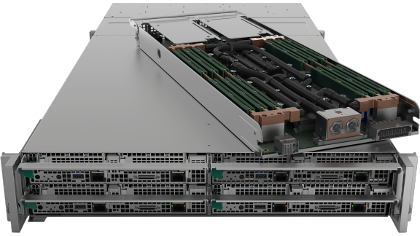
Overview
Task & Purpose
Market & Customer
Proposed by Intel
Robot to retrieve servers
Data warehouses
Industrial automation
Data infrastructure
Notes:
Chris
This project was proposed by Intel as a part of their research outreach. We chose this project because it exemplifies the different aspects of our mechanical engineering education
→ First principles
→ Problem solving
→ Team work
→ static and dynamic systems
→ Electrical, programming and control aspect
Inevitably we stood up to the challenge and each learned new things.
You might wonder, Why is this project interesting to a company like Intel?
In our market and customer analysis we found that by creating a robot that cuts down on maintenance time and service delays….
Robots like this serve a huge market, its gonna be great.
→ Data center market is projected to reach a net worth of 57 billion by 2024
→ Industrial automation is an ever growing industry: projected $7.8 trillion will be spent on it per year by 2026
→ Data infrastructure - server hardware etc. - worth $60 billion on its own by 2024
So why is Intel interested? Because they have an influence over 90% of the global server market.

Slide 4
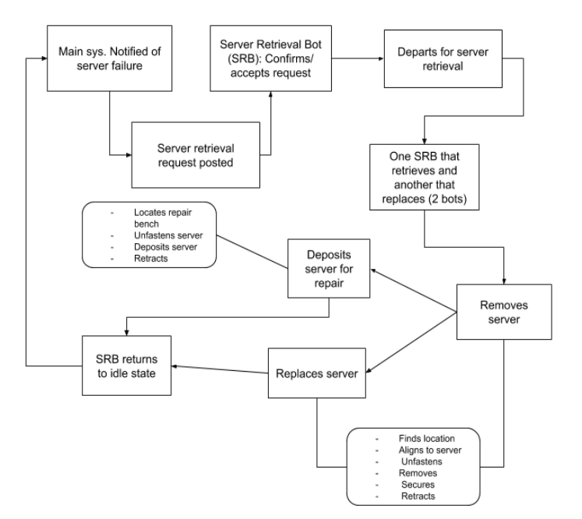
Operational Flow
Receives command
Confirms & departs
Retrieves server
Deposits server
Returns to idle state
Notes:
Arif

Slide 5
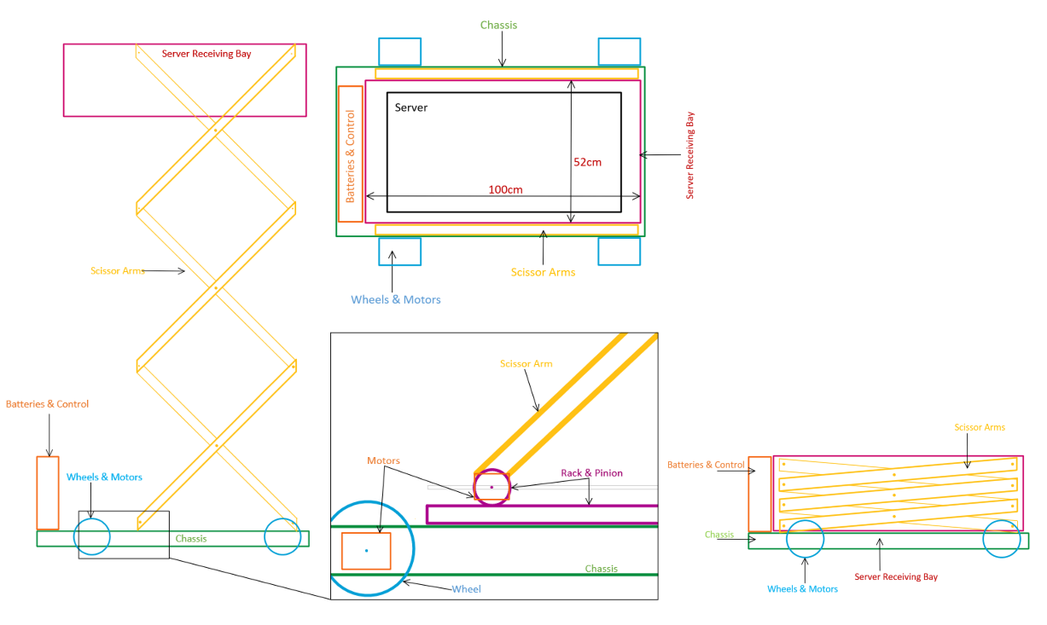
Final Design
Floor based design
Differential steering
Scissor lift
Versatile platform
Notes:
Chad

Slide 6
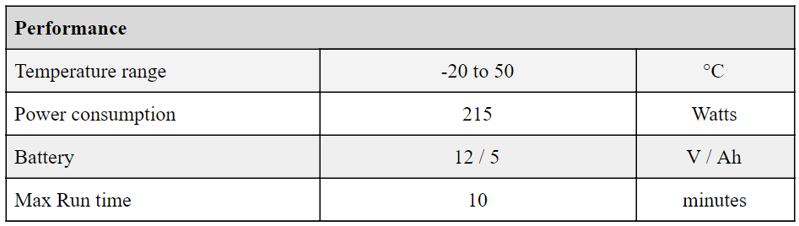
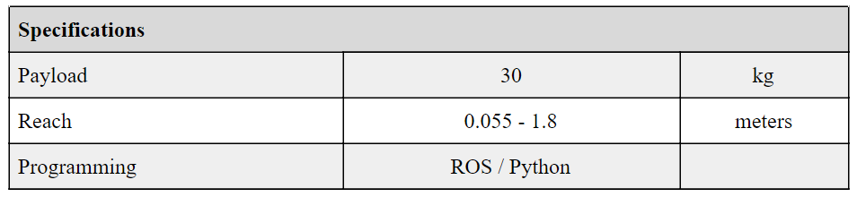
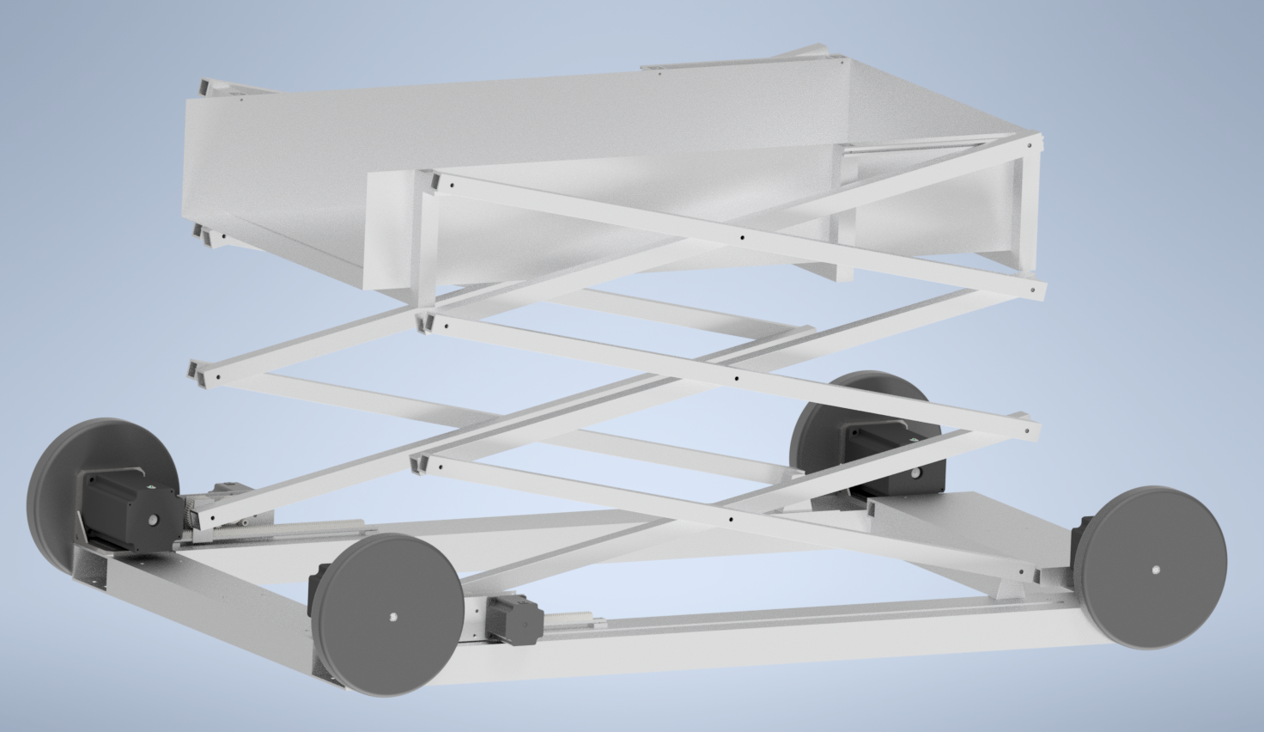
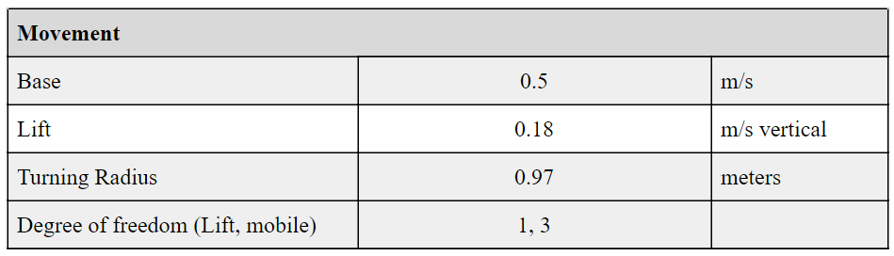
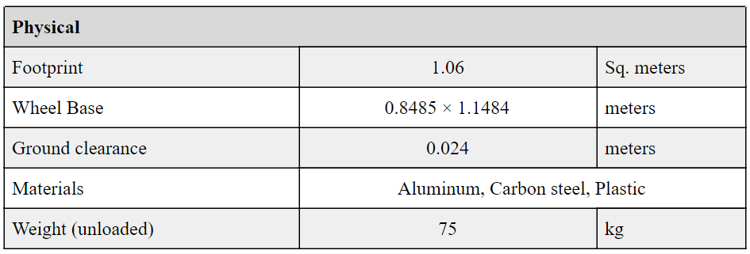
Final Design Specifications
Notes:
Chad

Slide 7
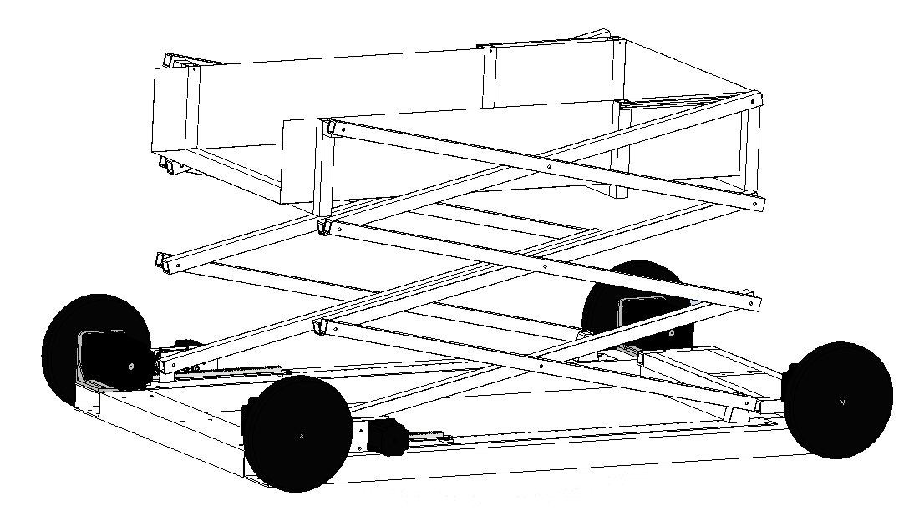
Scope of Design
Design Assumptions
Platform’s structure
Mobility system
Lift system
Mechatronic control
Navigation
Loading & offloading
Server & rack sizes
Notes:
Chris
The prompt for this project was very open ended: Build a robot.
Because of the truncated semester length and the limited experience of the team it was necessary to set some limits.
That being said, we limited the scope of our design and made some assumptions.
First, the design that we came up to is limited to:
→ the platform’s mobility and structure
→ The lift system
→ mechatronic control of the system
Second, some of the most important assumptions that were made are:
→ The robot’s navigation system: not up to industrial standards due to cost and complexity… This robot will have simple proof of concept nav/ mobility capabilities
→ The robot allows for an attachment which will load and offload the server - this simplified the design since we didn’t have access to servers to get good, detailed information on how they attach to their racks - also many different companies have different locking mechanisms…
→ Because we didn’t have specific size requirements, we fitted the robot to be able to handle the largest Intel server - about 30 inches long, about 64 pounds

Slide 8
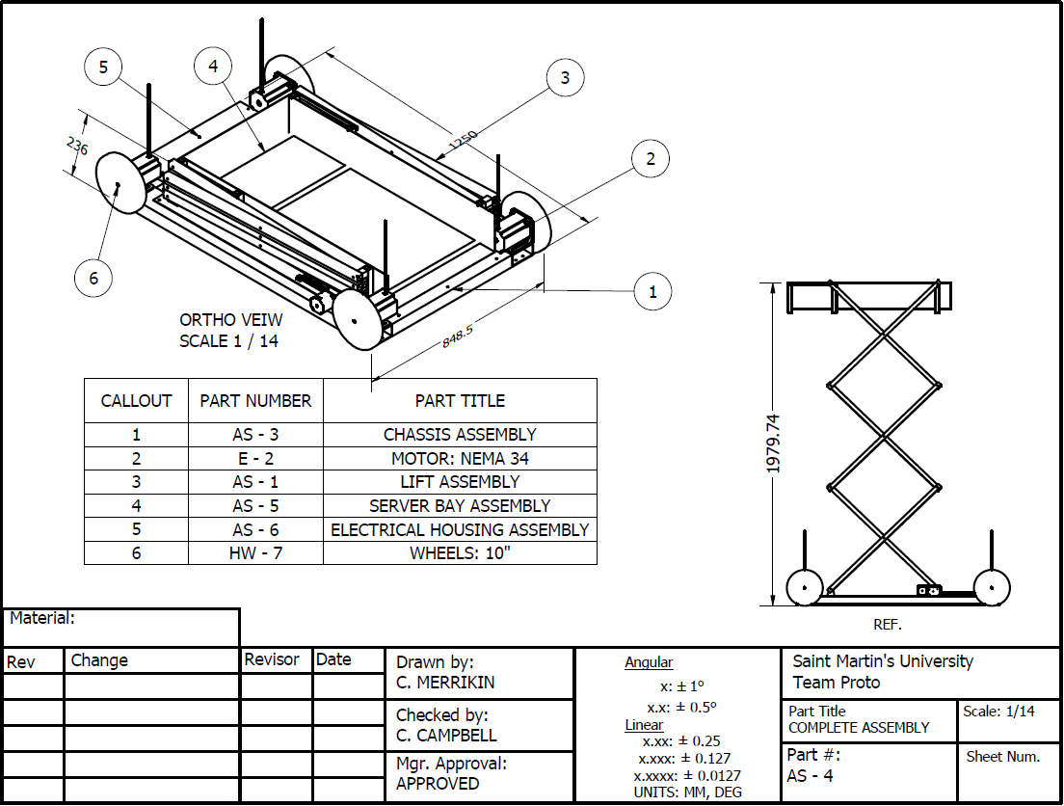
Design Subsystems
Chassis
Lift
Server Bay
Electromotive control
Notes:
Chris
When breaking down the design problem, we found that there are four major subsystems that compose this robot:
→ The chassis: all the parts mount to it, it supports the wiring harness and it serves as the mobility platform
→ The lift - raises and lowers the server bay
→ The server bay - serves as a platform where additional robotics can be mounted to load and offload servers
→ Electromotive control - this includes controlling all the actuation, navigation, and power regulation

Slide 9
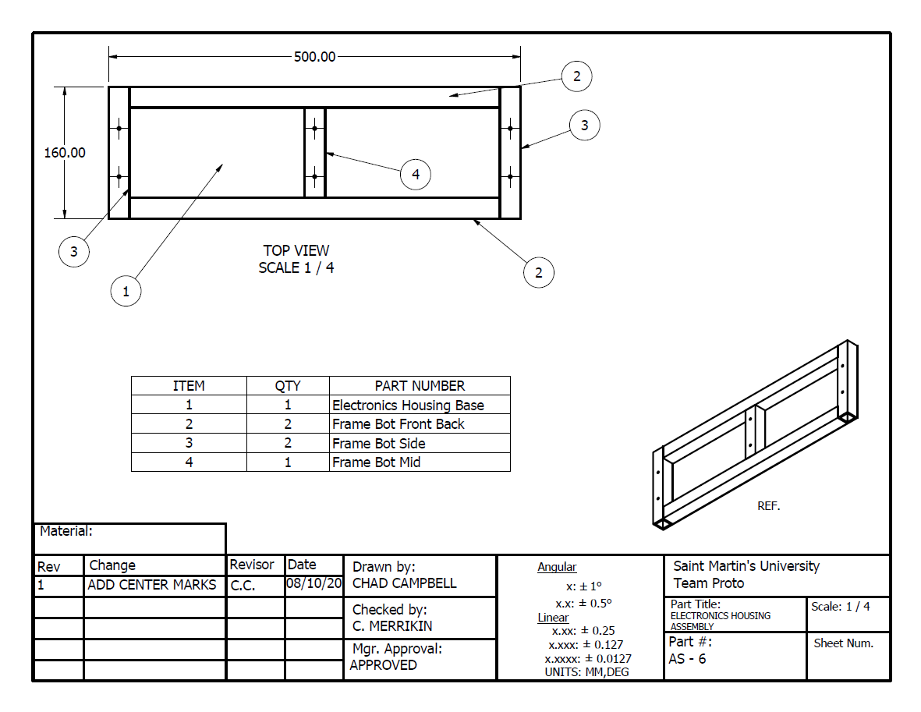
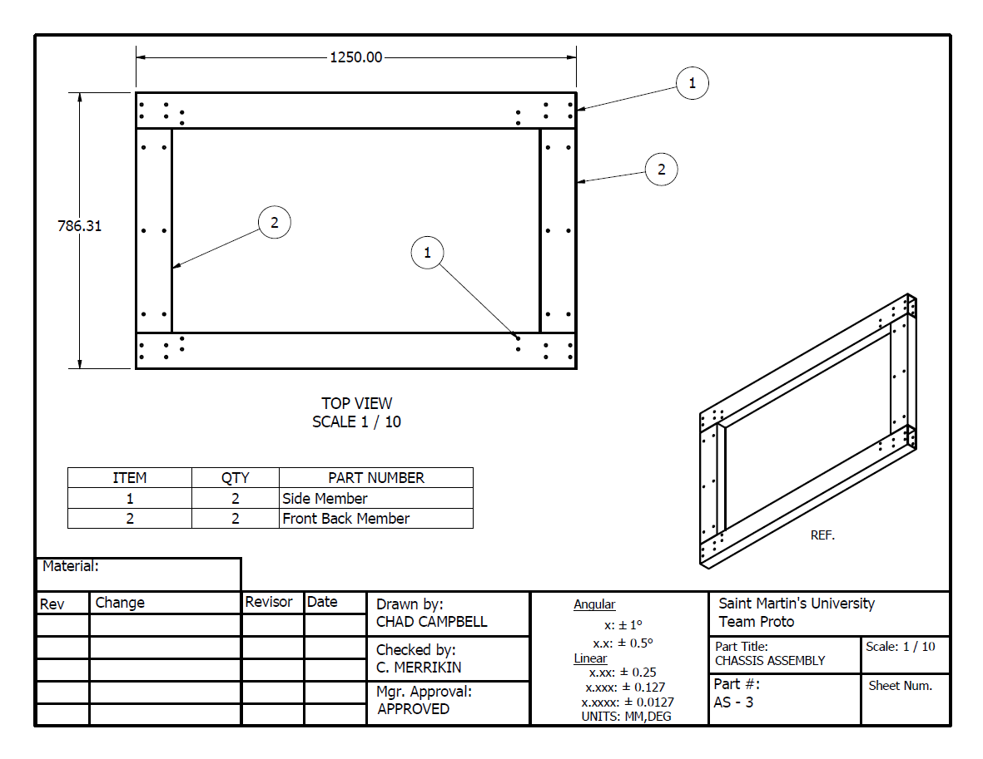
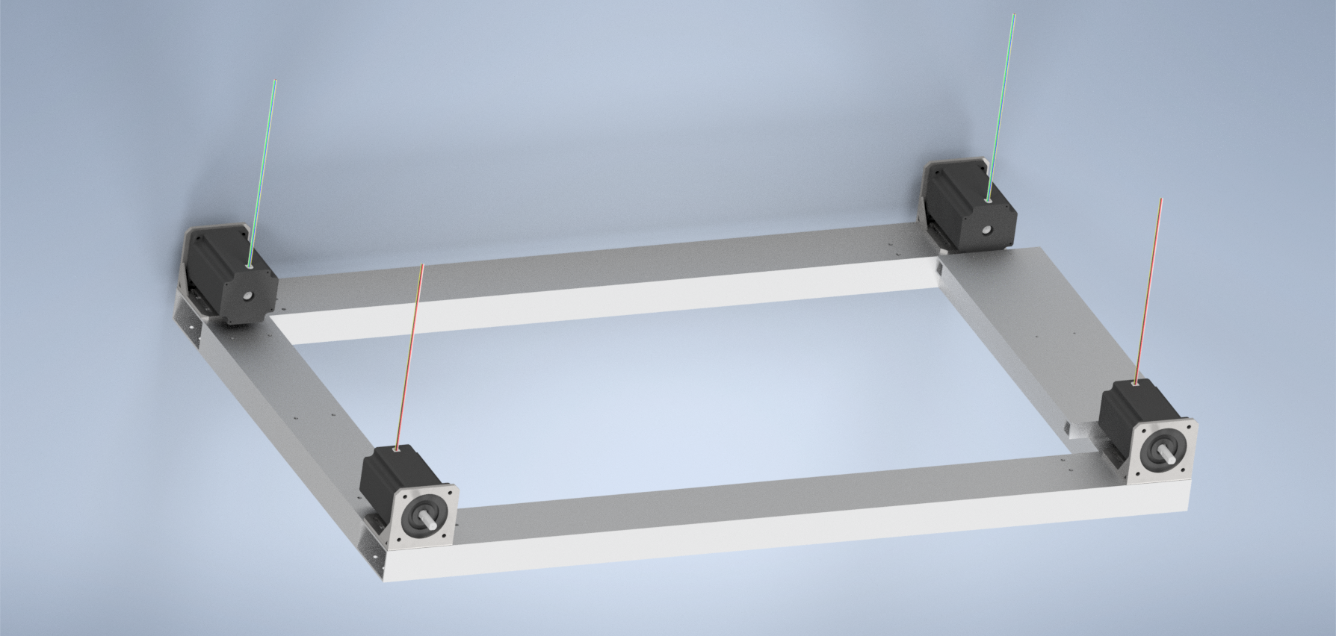
Chassis Assembly
Frame
Electrical Housing
Motors & Mounts
Notes:
Chad

Slide 10
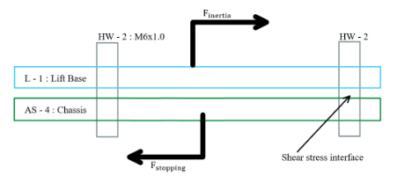
Chassis Assembly Analysis
Motor Shaft
Frame
Notes:
Chad

Slide 11
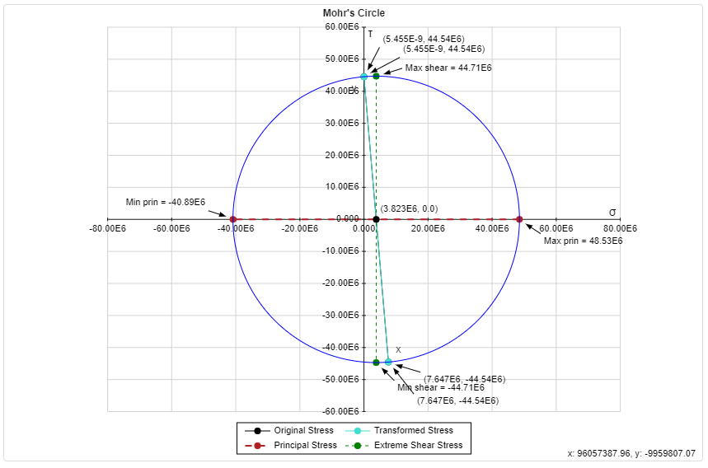
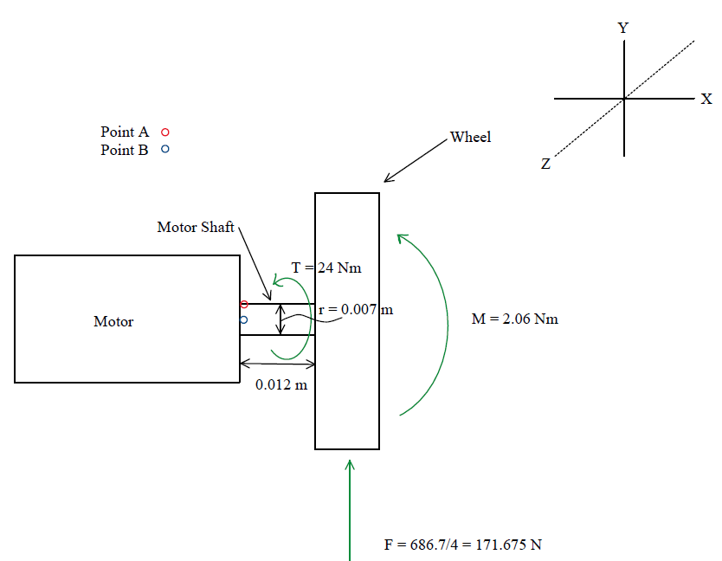
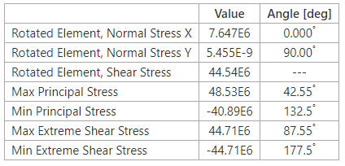
Motor Shaft Analysis
Applied Forces
Shear: 171.675 N
Bending: 2.06 Nm
Torque: 24 Nm
Notes:
Chad

Slide 12
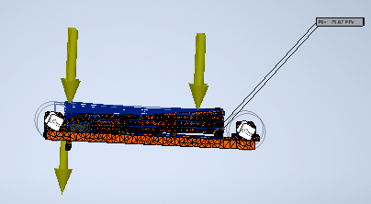
Chassis Analysis Results
Motor Shaft Results
Motor shaft
Static loading
Chassis Results
Initial Load: 441.45 N
Von Mises: 95.3 MPa
Principal Stress: 34.6 MPa
Notes:
Chad

Slide 13
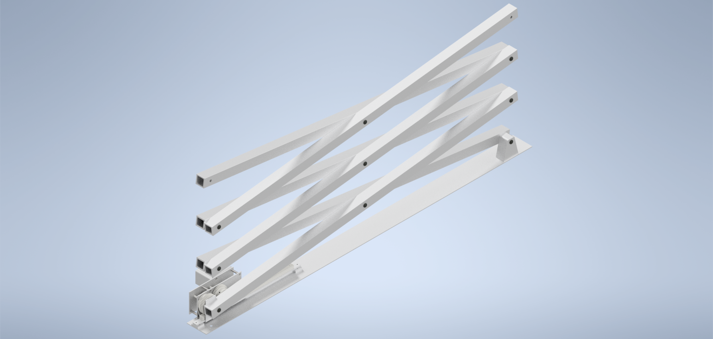
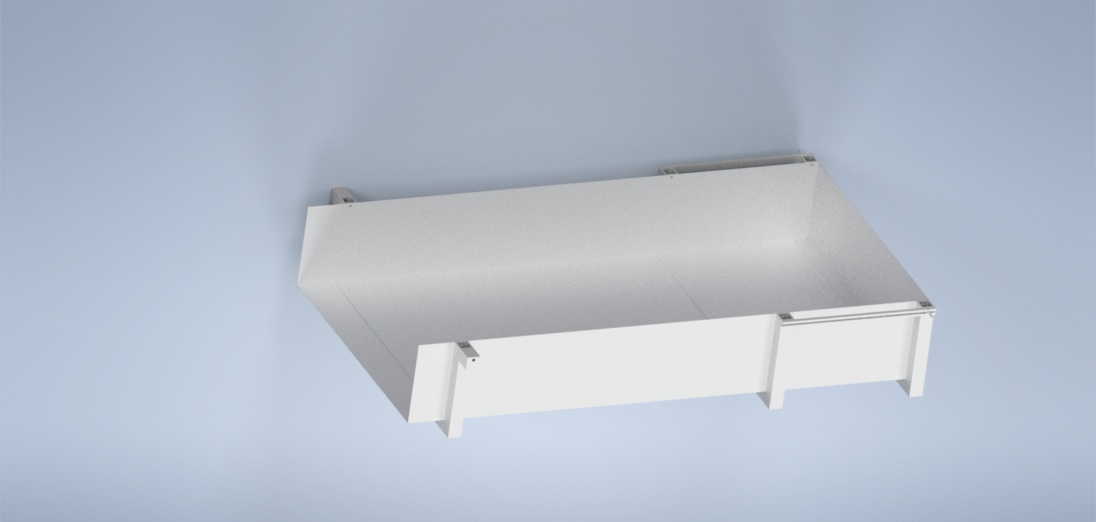
Lift Assembly
Arms
Gear Train
Server Bay
6061-T6 Aluminum
Fasteners
Gears
Notes:
Chris
The lift assembly consists of four main parts:
→ Gear train
→ Lifting arms
→ Server bay
→ supporting components: Base, spacers, fasteners
The material for the:
→ custom components is all 6061-T6 aluminum because of its low weight and high strength
→ fasteners are varying grades, steel alloys
→ gears are currently carbon steel

Slide 14
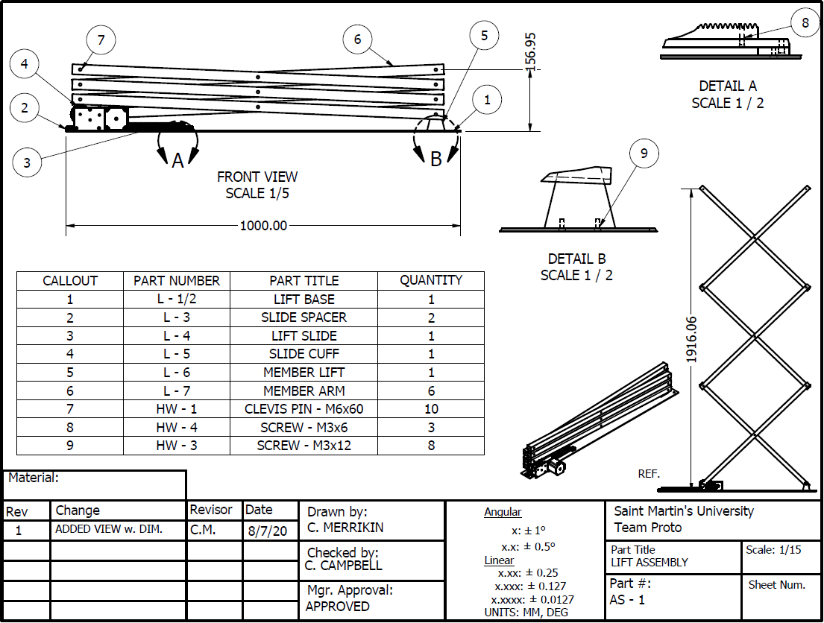
Lift Assembly Analysis
Stress & Concentrations
Structure
Gear Analysis
Notes:
Chris
To ensure the lift design does not fail analysis was completed on:
→ Structural configuration
→ Stress concentrations: Holes, fasteners
→ Gear Train

Slide 15
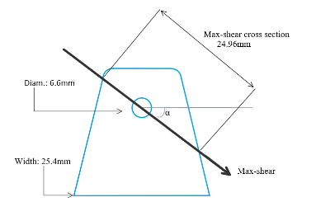
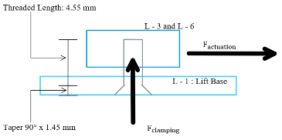
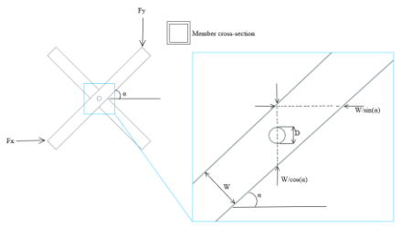
Lift Analysis Results
Stress Concentrations
Fatigue Cycle
Notes:
Chris
Stress concentrations:
Located at all fasteners and holes.
Analysis was done on M3×0.5 fasteners to ensure the countersunk material still had enough grip on fastener head.
→ stress transformation:
Given the loading and materials, the greatest point of stress was at the interface between lift’s baseplate and the spacers
Using the ISO recommended torque rating for M3 fine threads, a clamping load was calculated, the actuation force was known
Resulting max stress observed in transformation was 2.52 kPa, material rated for 297 MPa (yield strength), well within safety requirements for this project
→ Part that fixed support/ pin
Max shear force calculated and when coupled with the stress concentration resulted in nominal stress of 10.8 MPa
Again, within the material specs
→ Stress transformation conducted on point of max stress in lift arm
Where the two arms are pinned together
Stress transformation revealed that the max observed stress is 2.6 MPa
When utilizing the Goodman Criterion the resulting safety factor was 77.7

Slide 16
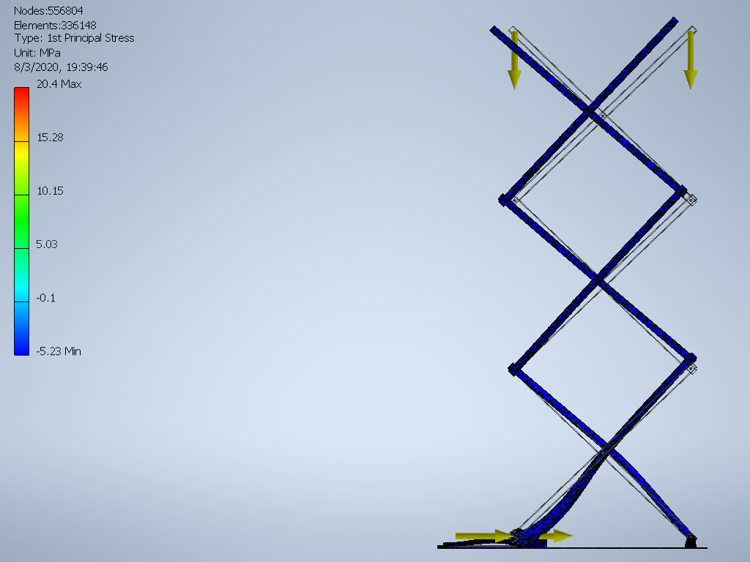
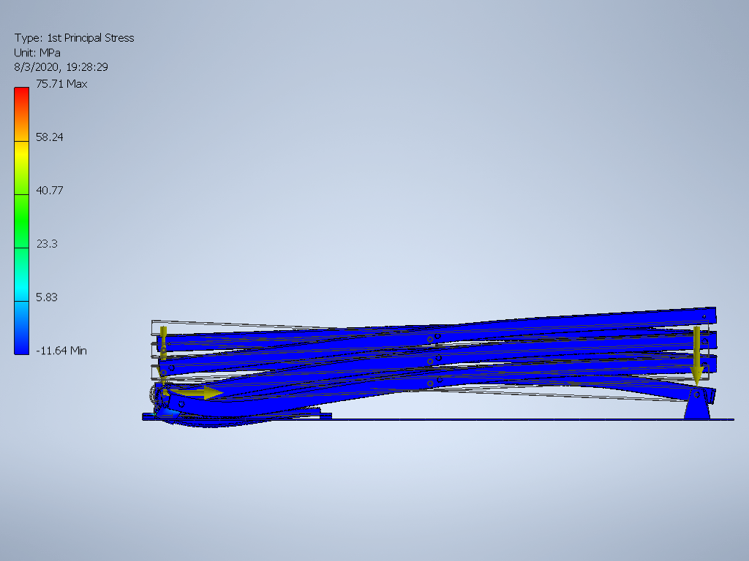
Lift Analysis Results
Structure
Orientation | Von Mises (MPa) | 1st Principal (MPa)
Collapsed | 97.2 | 75.7
Extended | 25.2 | 20.4
Notes:
Chris
Simulated the structure with static loading at top and bottom.
→ vertical force was weight of the server and retrieval hardware
→ Horizontal force is the actuation force required for each situations (greatest at the bottom, least at top: 2523 - 110 newtons)
→ Simulation is grounded at the base
Results:
Collapsed state ⇒ Von mises ( measure of whether the material has begun to yield) was 97.2 MPa and 1st principal was 75.7 MPa,
Both within SF of 2 range
Extended state ⇒ Von Mises was 25.2 and 1st principal was 20.4 MPa
Both well within material specs of 297 (SF2)

Slide 17
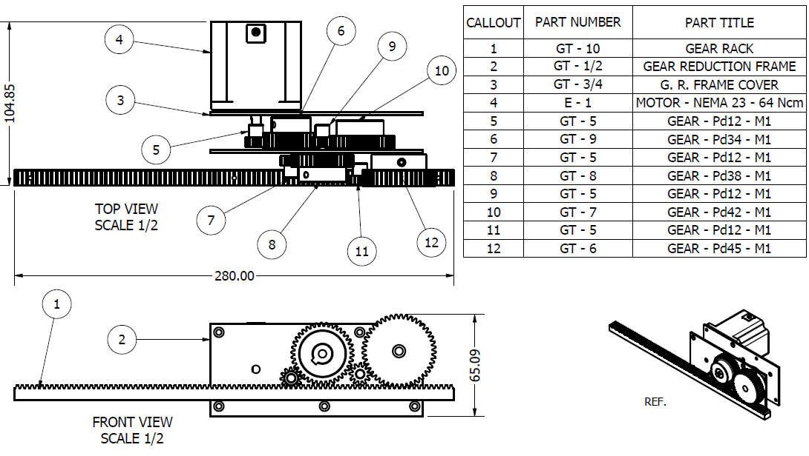
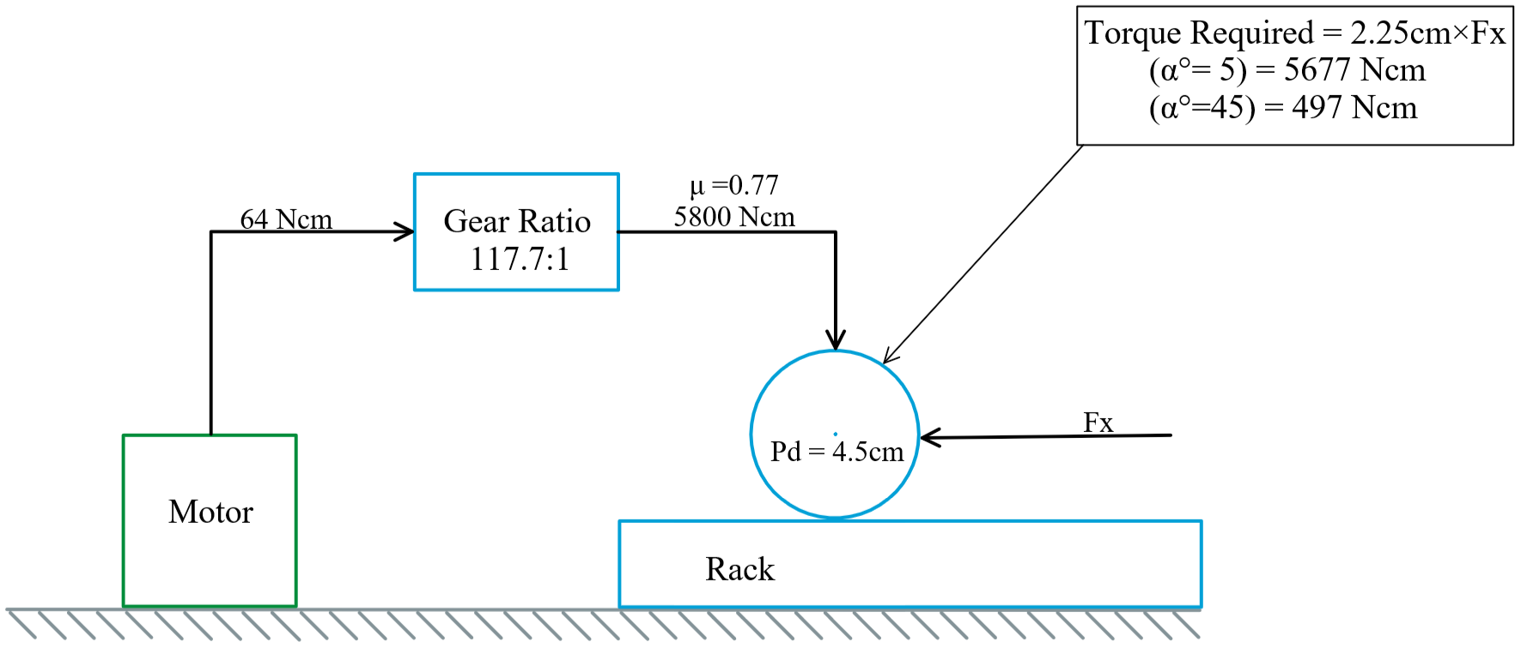
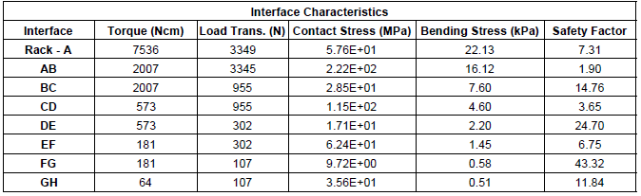
Lift Analysis Results
Gear Train
Notes:
Chris
Had to find a balance between motor cost and gearing cost
Output torque required was Maximum of 5677 Ncm
Input torque from selected NEMA 23 motor was 64 Ncm
Gear ratio required: 118 → this accounts for a 77% efficiency
Calculated the tooth bending stress and contact stress between gears
Found SF to be a minimum of 1.9 → American Gear Manufacturers association suggests SF between 1 and 1.5

Slide 18
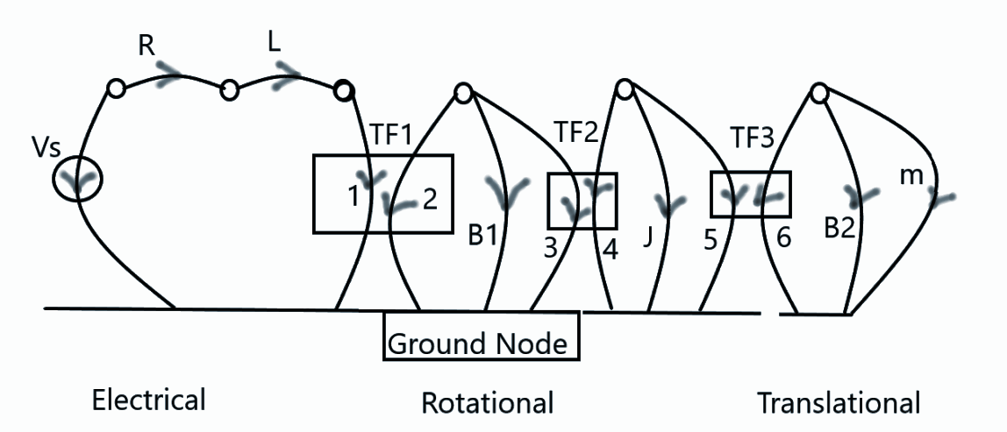
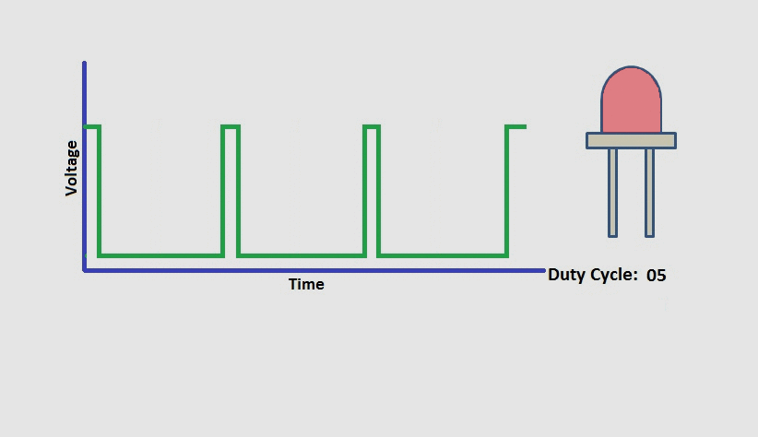
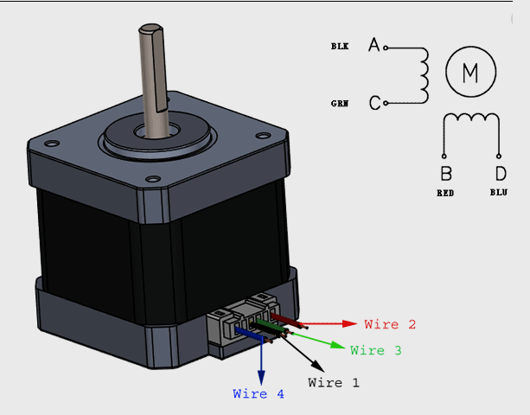
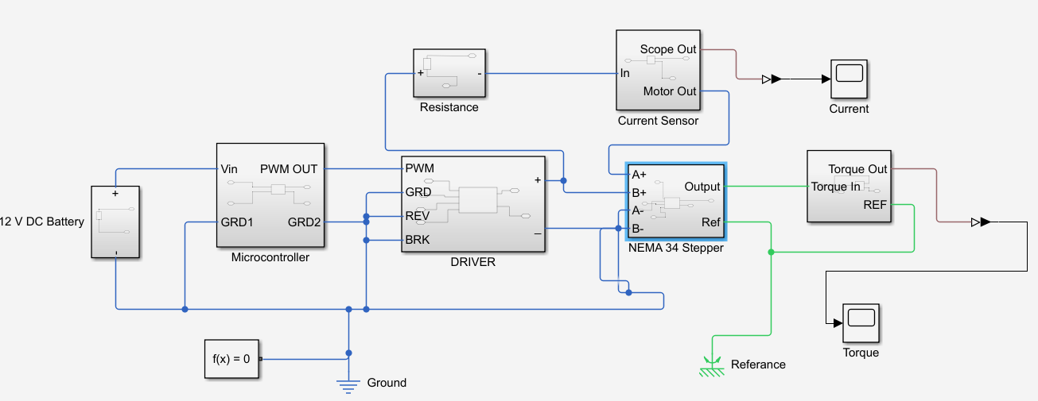
System Dynamics
Mathematical Model
Real World Components
Sate Vector X = [ i ; T ]
Simulink Simulation
Notes:
Arif

Slide 19

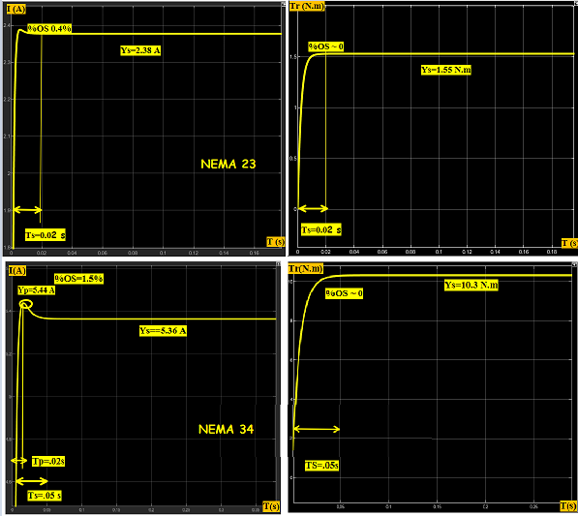
Dynamics & Control
Current
Torque
Transient State : %Overshoot , settling time Ts
Steady State : Yss (steady state response)
Gain constant : K
Motor Response Curves
Notes:
Arif

Slide 20
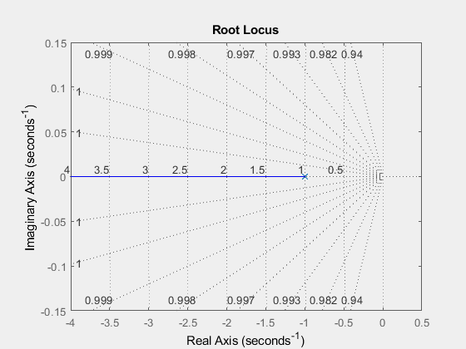
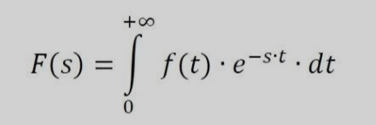
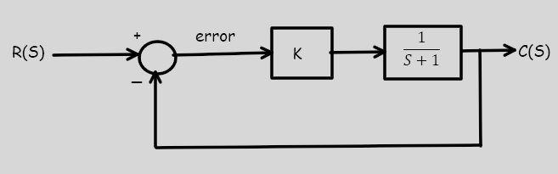
Control Analysis
Time Domain
S Domain
Laplace transform
PID CONTROL WITH ROOT LOCUS
Feedback Loop
Notes:
Arif

Slide 21
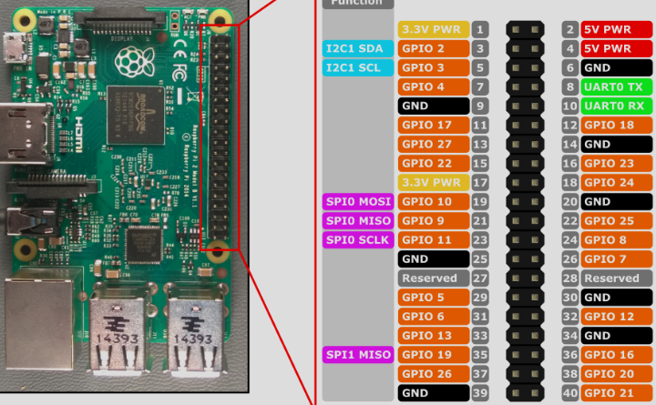

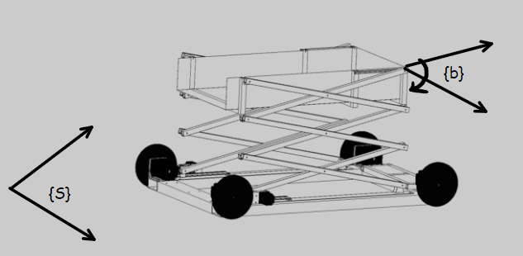
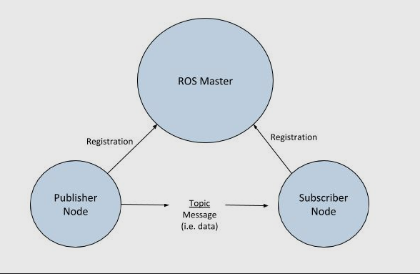

Computer and Programming
Hardware : Arduino or RsPy 4, sensors
Coding: C++ or Python
Algorithm Parameters and mathematics
Notes:
Arif

Slide 22
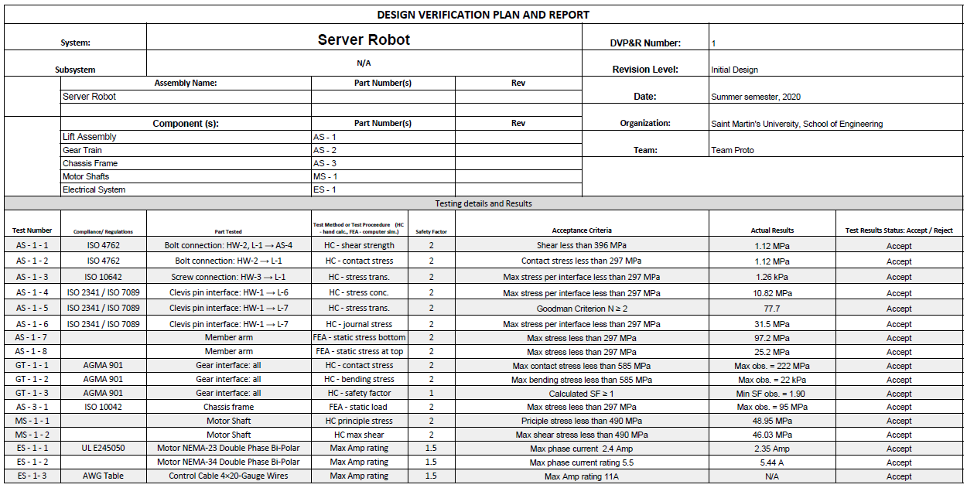
DVP&R
Notes:
Chad

